Slide 1
Copyright © 2014 Pearson Education, Inc.

Slide 2
Chapter 10
Social Networks, Auctions, and Portals
Copyright © 2014 Pearson Education, Inc.

Slide 3
Social Network Fever
Spreads to the Professions
How has the growth of social networks enabled the creation of more specific niche sites?
What are some examples of social network sites with a financial or business focus?
Describe some common features and activities on these social network sites.
What features of social networks best explain their popularity?
Copyright © 2014 Pearson Education, Inc.
Slide 10-<number>

Slide 4
Social Networks and Online Communities
Internet began as communications medium for scientists
Early communities were bulletin boards, newsgroups; e.g.: the Well
Today social networks, photo/video sharing, blogs have created new era of online socializing
Social networks now one of most common Internet activities
Copyright © 2014 Pearson Education, Inc.
Slide 10-<number>

Slide 5
What Is an Online Social Network?
Working definition
  Group of people
  Shared social interaction
  Common ties
  Sharing an area for period of time
Copyright © 2014 Pearson Education, Inc.
Slide 10-<number>

Slide 6
The Growth of Social Networks and Online Communities
Top 10 social networks account for over 90% social networking activity
Facebook users: Over 50% are 35+
Annual advertising revenue
  U.S. social network sites: $3.1 billion
  Top four portal/search engines: $17.5 billion
Copyright © 2014 Pearson Education, Inc.
Slide 10-<number>

Slide 7
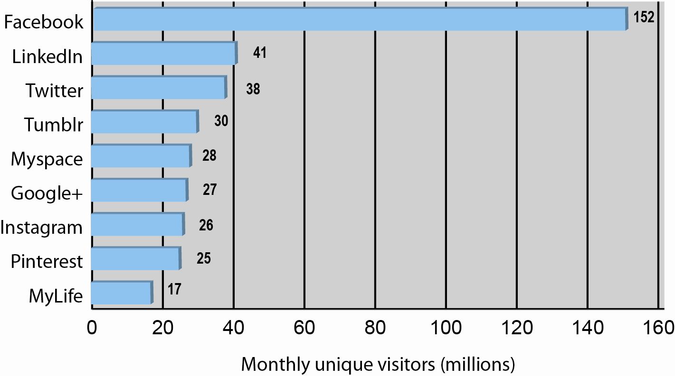
Top 10 Social Network Sites 2012
Figure 10.1, Page 387
SOURCES: Based on data comScore, 2012a; Gaudin, 2012; McGee, 2012.
Copyright © 2014 Pearson Education, Inc.
Slide 10-<number>

Slide 8
Turning Social Networks into Businesses
Social networks monetizing audiences through advertising
Business use of social networks
  Marketing and branding tool
    Facebook pages, “fans”
    Twitter feeds
  Listening tool
    Monitoring online reputation
Copyright © 2014 Pearson Education, Inc.
Slide 10-<number>

Slide 9
Types of Social Networks
General communities
Practice networks
Interest-based social networks
Affinity communities
Sponsored communities
Copyright © 2014 Pearson Education, Inc.
Slide 10-<number>

Slide 10
Social Network Features and Technologies
Profiles
Friends network
Network discovery
Favorites
Games, widgets, apps
E-mail
Storage
Instant messaging
Message boards
Online polling
Chat
Discussion groups
Experts online
Membership management tools
Copyright © 2014 Pearson Education, Inc.
Slide 10-<number>

Slide 11
The Future of Social Networks
Facebook’s growth has slowed
Growth of social networks focused on specific shared interests
Network fatigue
  Reuter study shows Facebook users spending less time on the site
Financial future
  Relationship between sales and Likes unclear
Copyright © 2014 Pearson Education, Inc.
Slide 10-<number>

Slide 12
Facebook Has Friends
Why have Facebook applications become so popular? Do they have any limitations?
What are the core differences between Google+ and Facebook? Does Google+ offer significant advantages?
How has Microsoft responded?
Is Tumblr a significant competitor? Why or why not?
Copyright © 2014 Pearson Education, Inc.
Slide 10-<number>

Slide 13
Online Auctions
Online auction sites are among the most popular C2C sites on the Internet
eBay: Market leader
Several hundred different auction sites in United States alone
Established portals and online retail sites increasingly are adding auctions to their sites
Copyright © 2014 Pearson Education, Inc.
Slide 10-<number>

Slide 14
Defining and Measuring the Growth of Auctions and Dynamic Pricing
Dynamic pricing
  Airline tickets, coupons, college scholarships
  Prices based on demand characteristics of customer and supply situation of seller
Auctions: type of dynamic pricing
  C2C auctions
  B2C auctions
  Also used to allocate resources, allocate and bundle resources
Copyright © 2014 Pearson Education, Inc.
Slide 10-<number>

Slide 15
Benefits of Auctions
Liquidity
Price discovery
Price transparency
Market efficiency
Lower transaction costs
Consumer aggregation
Network effects
Copyright © 2014 Pearson Education, Inc.
Slide 10-<number>

Slide 16
Risks and Costs of Auctions for
Consumers and Businesses
Delayed consumption costs
Monitoring costs
Equipment costs
Trust risks
  Possible solution—rating systems
Fulfillment costs
Copyright © 2014 Pearson Education, Inc.
Slide 10-<number>

Slide 17
Market-maker Benefits
No inventory
No fulfillment activities
  No warehouses, shipping, or logistical facilities
eBay makes money from every stage in auction cycle
  Transaction fees
  Listing fees
  Financial services fees
  Advertising or placement fees
Copyright © 2014 Pearson Education, Inc.
Slide 10-<number>

Slide 18
Types of Auctions
English auctions
  Single item up for sale to single seller
  Highest bidder wins
Traditional Dutch auction
  Uses a clock that displays starting price
  Clock ticks down price until buyer stops it
Dutch Internet auction
  Public ascending price, multiple units
  Final price is lowest successful bid, which sets price for all higher bidders
Copyright © 2014 Pearson Education, Inc.
Slide 10-<number>

Slide 19
Types of Auctions (cont.)
Name Your Own Price Auctions
  Users specify what they are willing to pay for goods or services and multiple providers bid for their business
  Prices do not descend and are fixed
    Consumer offer is commitment to buy at that price
  Enables sellers to unload unsold excess capacity
  e.g.: Priceline
Copyright © 2014 Pearson Education, Inc.
Slide 10-<number>

Slide 20
Types of Auctions (cont.)
Group buying auctions (demand aggregators)
  Group buying of products at dynamically adjusted discount prices based on high volume purchases
  Two principles
    Sellers more likely to offer discounts to buyers purchasing in volume
    Buyers increase their purchases as prices fall
Professional service auctions
  e.g.: Elance.com
Copyright © 2014 Pearson Education, Inc.
Slide 10-<number>

Slide 21
Factors to Consider When Choosing Auctions
CONSIDERATIONS | DESCRIPTION
Type of product | Rare, unique, commodity, perishable
Stage of product life cycle | Early, mature, late
Channel-management issues | Conflict with retail distributors; differentiation
Type of auction | Seller vs. buyer bias
Initial pricing | Low vs. high
Bid increment amounts | Low vs. high
Auction length | Short vs. long
Number of items | Single vs. multiple
Price-allocation rule | Uniform vs. discriminatory
Information sharing | Closed vs. open bidding
Table 10.5, p 397
Copyright © 2014 Pearson Education, Inc.
Slide 10-<number>

Slide 22
When Auction Markets Fail:
Fraud and Abuse in Auctions
Possible abuses and frauds
  Bid rigging, price matching, shill feedback, etc.
Internet auto-auction fraud one of top 10 types of fraud reported
  Safeguards: rating systems, watch lists, proxy bidding
Copyright © 2014 Pearson Education, Inc.
Slide 10-<number>

Slide 23
E-commerce Portals
Most frequently visited sites on Web
Original portals were search engines
  As search sites, attracted huge audiences
Today provide:
  Navigation of the Web
  Commerce
  Content (owned and others’)
Compete on reach and unique visitors
Enterprise portals
  Help employees find important organizational content
Copyright © 2014 Pearson Education, Inc.
Slide 10-<number>

Slide 24
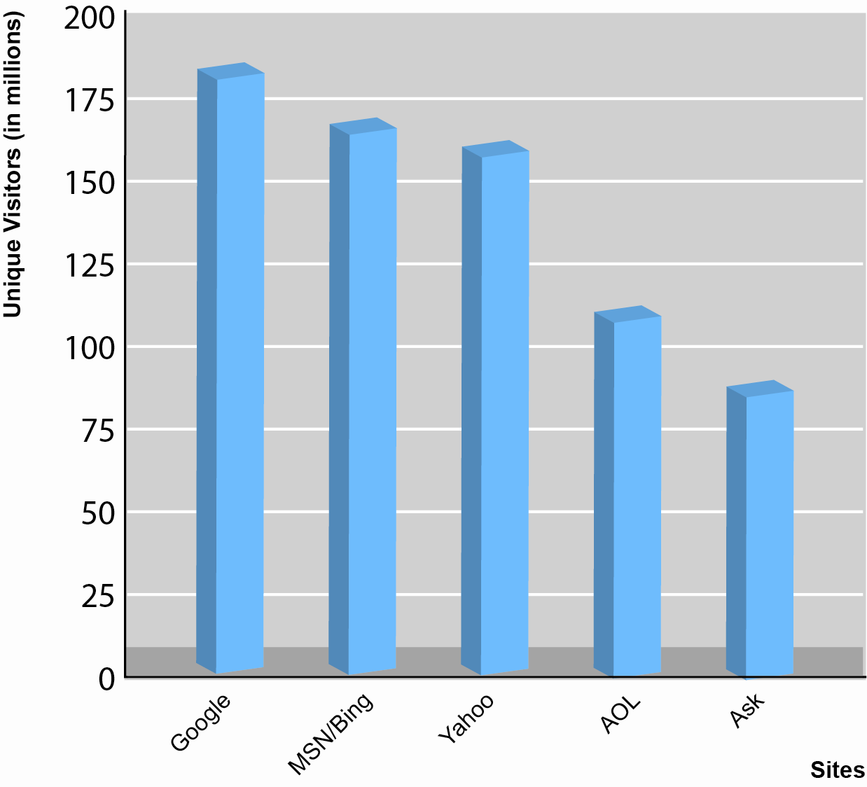
Top Five Portal/Search Engines in United States
SOURCE: Based on data from comScore, 2012.
Figure 10.3, Page 401
Copyright © 2014 Pearson Education, Inc.
Slide 10-<number>

Slide 25
The Transformation of AOL
What types of decisions have led to AOL’s decline in popularity?
What are AOL’s current strategies?
Do you think its new strategies will succeed?
Copyright © 2014 Pearson Education, Inc.
Slide 10-<number>

Slide 26
Types of Portals
General purpose portals
  Attempt to attract very large general audience
  Retain audience by providing in-depth vertical content channels
  e.g.: Yahoo, MSN
Vertical market portals
  Attempt to attract highly-focused, loyal audiences with specific interest in:
    Community (affinity group); e.g.: iVillage
    Focused content; e.g.: ESPN.com
Copyright © 2014 Pearson Education, Inc.
Slide 10-<number>

Slide 27
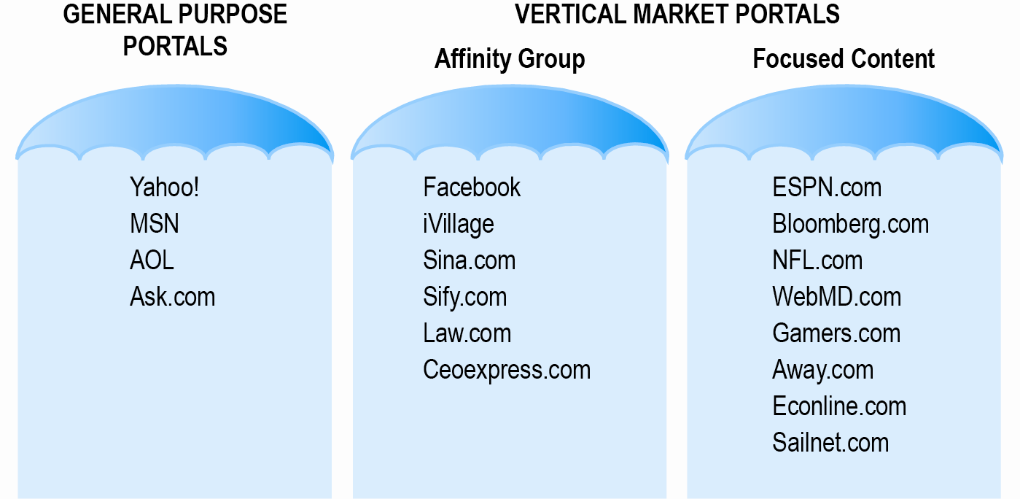
Two General Types of Portals:
General Purpose and Vertical Market Portals
Figure 10.4, Page 403
Copyright © 2014 Pearson Education, Inc.
Slide 10-<number>

Slide 28
Portal Business Models
General advertising revenue
Tenancy deals
  Fixed charge for number of impressions, exclusive partnerships, “sole providers”
Commissions on sales
Subscription fees
  Charging for premium content
Applications and games
Copyright © 2014 Pearson Education, Inc.
Slide 10-<number>

Slide 29

Copyright © 2014 Pearson Education, Inc.
Slide 10-<number>

